Slide 1

ARTIFICIAL INTELLIGENCE (AI)

Slide 2

• AI enables machines to perform tasks requiring human intelligence.
• Includes learning, reasoning, pattern recognition, and decision-making.
• Core technologies behind smart assistants, robotics, automation.
INTRODUCTION TO AI

Slide 3




KEY TECHNOLOGIES IN AI
• Machine Learning (ML)
• Deep Learning (DL)
• Natural Language Processing (NLP)
• Computer Vision
• Reinforcement Learning
• Tools: Python, TensorFlow, PyTorch, OpenCV

Slide 4



• Apollo Hospitals
• AI-driven predictive analytics for early disease detection.
• Personalized treatment recommendations.
.
• Radiology image analysis.
INDIAN USE CASE

Slide 5
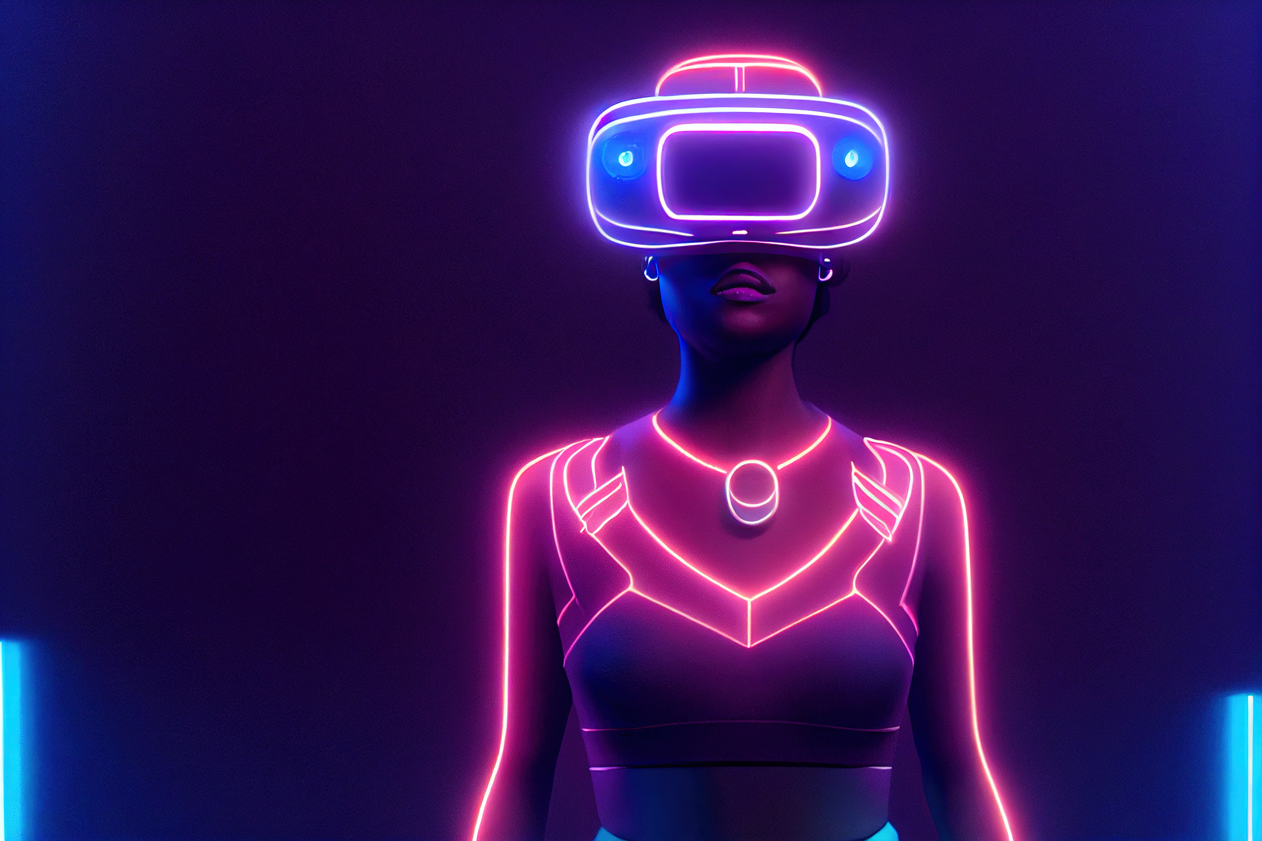
GLOBAL USE CASE
• Tesla – Autonomous Vehicles
• Uses deep learning and computer vision.
• Enables self-driving features and real-time decision-making.

Slide 6

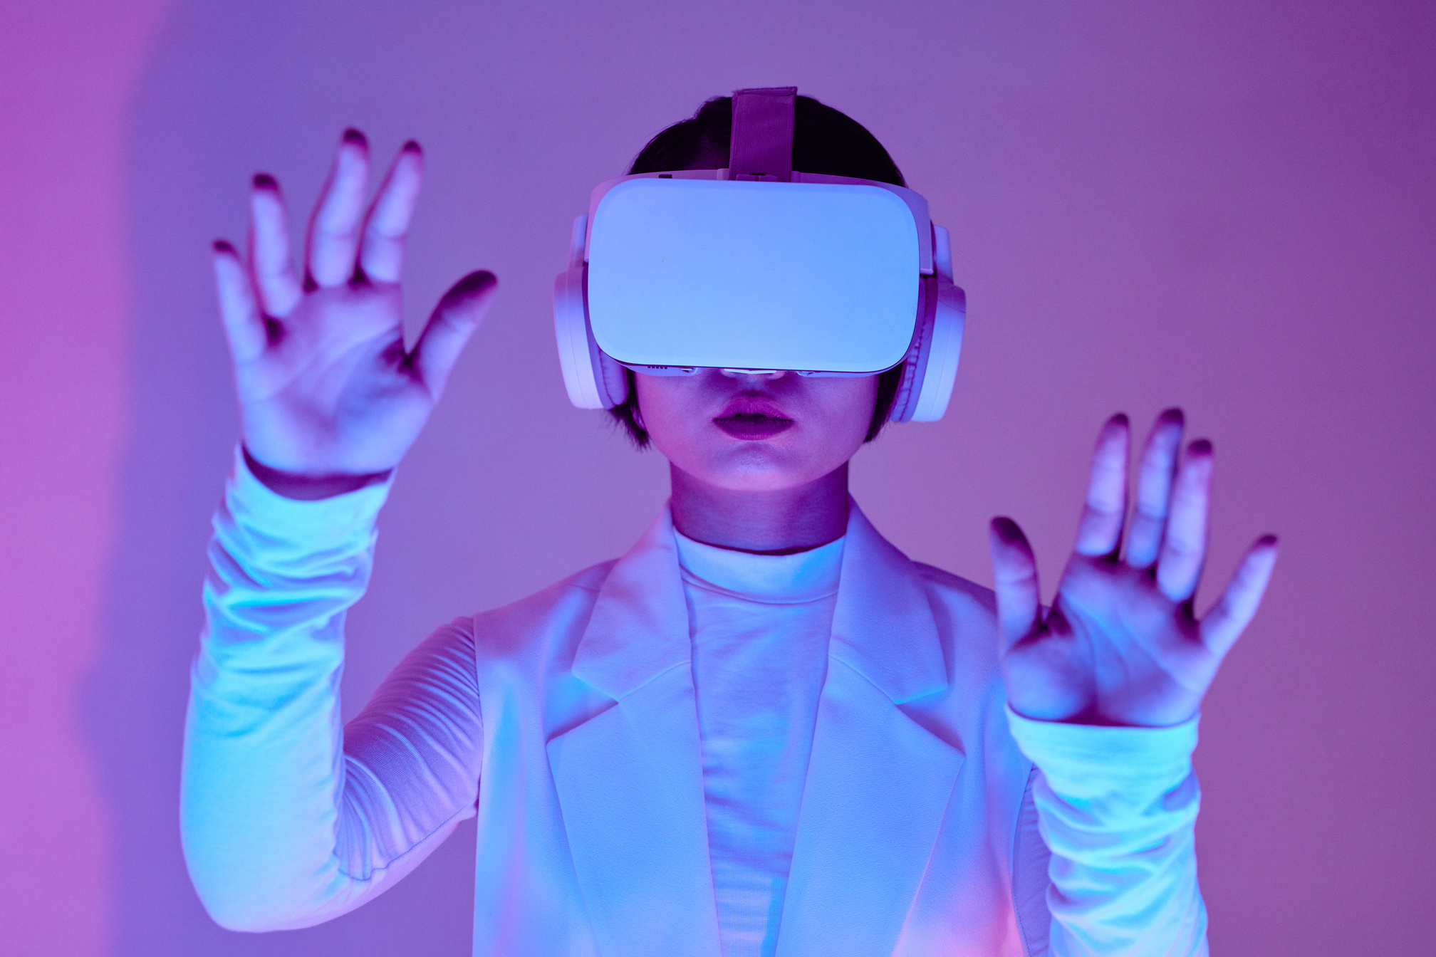
CAREER OPPORTUNITIES
• AI Engineer, ML Engineer, Data Scientist
• NLP Engineer, Computer Vision Engineer
• Skills: Python, ML/DL, Statistics, Cloud Tools
• High demand across healthcare, finance, automotive, retail

Slide 7

• AI aligns with my interest in problem-solving and innovation.
• I have basic Python skills and logical thinking.
REFLECTION
• Aim to learn ML, DL, statistics, and work on real projects.
• Goal: Become an AI Engineer or Data Scientist.

Slide 8

THANK YOU!

